Slide 1
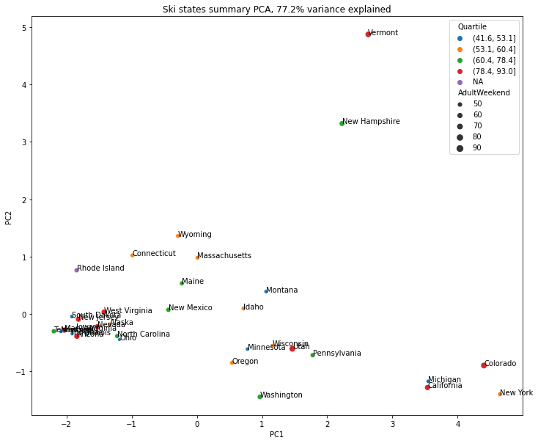

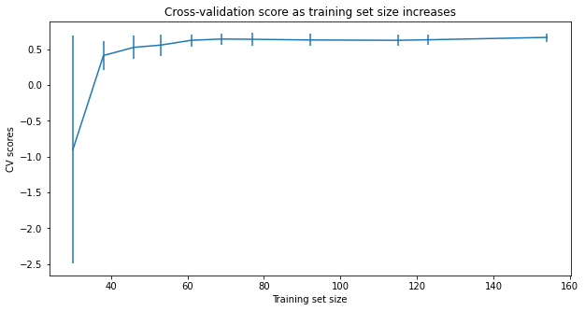
Big Mountain Case Study
Mohammed Abdin
Guided Capstone Project
Big Mountain Resort, Data Analysis Report
Problem Identification
What opportunities exist for Big Mountain Resort to reduce operating costs while safely maintaining 350’000 visitors in order to offset a $1.54M investment in a new chair lift?
Results
Initial Principal Components analysis shows that Montana (red circle) falls roughly within the area where the majority of all states are located (green circle). In the first two components PC1 and PC2, the states show a considerable spread. New York and Colorado have higher values in the first dimension. Michigan, California, Vermont and New Hampshire have higher values in the second dimension than the other states.
Given the observed pattern
the state parameter does not seem to be significant.
Modeling
A random forest model was chosen as the final model because it has a lower cross-validation mean absolute error by almost $1 and it exhibits less variability than a linear regression model.
Assessing data quality indicates that additional data will not improve the model significantly.
There's an initial rapid
improvement in model scores but it levels off at a sample size of 40-50.
Additional data that would
be useful are the actual operating costs of the resort.

Slide 2
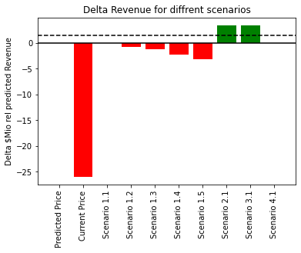
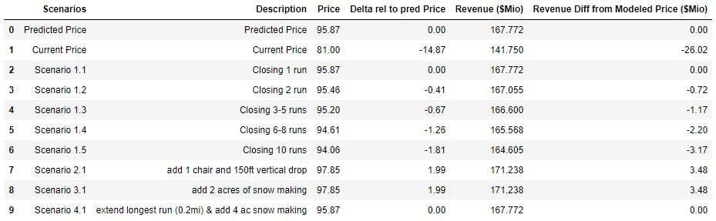
Big Mountain Case Study
Mohammed Abdin
Guided Capstone Project
The Random Forest model that yielded the best results used the median value to impute missing values and did not scale the data. The mean absolute cross-validation error (MAE) of the Random Forest model is 9.$64 with a standard deviation of $1.35. The MAE for the models prediction is $9.54.
The most important features are in descending order of their relative importance: fastQuads: 0.26, Runs: 0.256, Snow Making_ac: 0.116, Vertical_drop: 0.09
Big mountain currently charges $81.00. The developed Random forest model suggests that a ticket price up to ~$95 could be justified given Big Mountain's facilities. According to the initial information given it seems that management is aware that the current price is low for the amenities offered. I would therefore first approach management and ask if they could explain how the current ticket price was determined. Based on that information I would then suggest by how much the ticket price should be increased. Simply offsetting the $1.54M investment (black dashed line) for the new lift could be achieved by raising daily ticket prices by
~$0.9. This however would not cover the higher
operating costs incurred by the new lift. It would therefore be useful to request management to share the operating costs in order to be able to assess the increase required to fully cover the costs
of the new lift.
Recommendations
Different scenarios were modeled
In general it's difficult to recommend any of the 1.x scenarios without knowing the savings in operating costs for closing certain runs. However I would consider implementing Scenario 2.1 (add 1 chair and 150ft vertical drop) and potentially scenario 1.3 or 1.4 (dropping 5 or 8 runs respectively). While scenarios 1.3 and 1.4 might justify a drop in price the cost savings of not having to maintain these runs might offset the revenue loss.

